Slide 1

Taught By:
Daniel Opoku (Ph.D.)
EE 288 (ELECTRICAL) MEASUREMENT
& INSTRUMENTATION
CONTACT
c/o:
Address: Department of Electrical Engineering
KNUST, Kumasi, Ghana
E-mail: dopoku.coe@knust.edu.gh
Phone: 0553604143
Office: Opposite COE Department (Temp)
Semester 2, 2016/2017

Slide 2
Sensors
Sensing employ various physical principle in their operation.
These physical principles include:
Capacitance change,
Resistance change,
Magnetic phenomena (inductance, reluctance, and eddy currents),
Hall effect,
Properties of piezoelectric materials,
Resistance change in stretched/ strained wires (strain gauges),
Properties of piezoresistive materials,
Light transmission (both along an air path and along a fiber-optic cable),
Properties of ultrasound,
Transmission of radiation,
Properties of micromachined structures (microsensors).

Slide 3
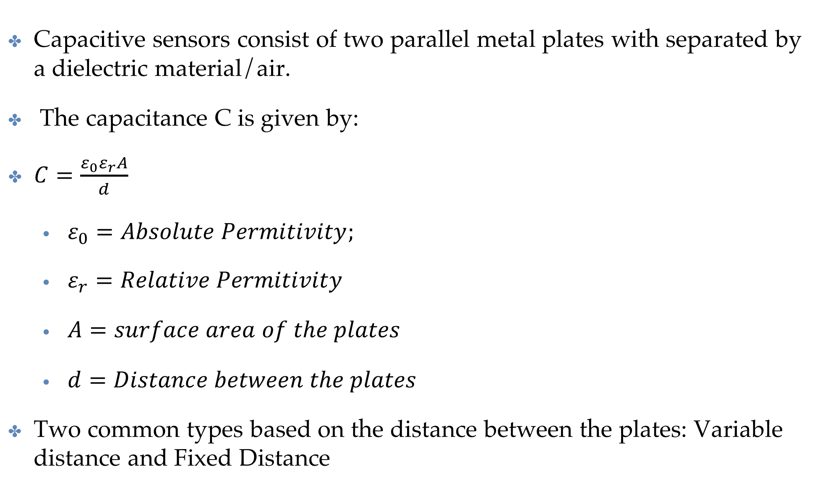
Sensors
[Capacitive sensors]
Capacitive sensors consist of two parallel metal plates with separated by a dielectric material/air.
The capacitance C is given by:
$C=\frac{ε_{0}ε_{r}A}{d}$
$ε_{0}=Absolute Permitivity;$
$ε_{r}=Relative Permitivity$
$A=surface area of the plates$
$d=Distance between the plates$
Two common types based on the distance between the plates: Variable distance and Fixed Distance

Slide 4
Sensors
[Capacitive sensors]
Variable Distance: The distance between the plates is variable.
Primarily displacement sensors: Motion of a variable plate relative to a fixed plate.
Motion to be measured can be applied to the moveable capacitor plate.
Capacitive displacement sensors commonly form part of instruments measuring pressure, sound, or acceleration.

Slide 5
Sensors
[Capacitive sensors]
Fixed Distance: Variation in capacitance is achieved by changing the dielectric constant of the material between the plates.
E.g. For Humidity sensor by measuring the moisture content of the air. The Dielectric medium is air.
As a liquid level sensor: The dielectric is partly air and partly liquid according to the level of the liquid that the device is inserted in.

Slide 6
Sensors
[Resistive Sensors]
Resistive sensors rely on variation of the resistance of a material when the measured variable is applied to it.
Commonly used in temperature measurement
Resistance Thermometers or Thermistors.
Also used in displacement measurement using strain gauges or piezoresistive sensors.
Besides, some moisture meters work on the resistance-variation principle.

Slide 7
Sensors
[Magnetic Sensors]
Magnetic sensors utilize the magnetic phenomena of inductance, reluctance, and eddy currents to indicate the value of the measured quantity, which is usually some form of displacement.
Inductive sensors translate movement into a change in the mutual inductance between magnetically coupled parts.
E.g. The inductive displacement transducer.

Slide 8
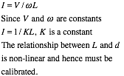
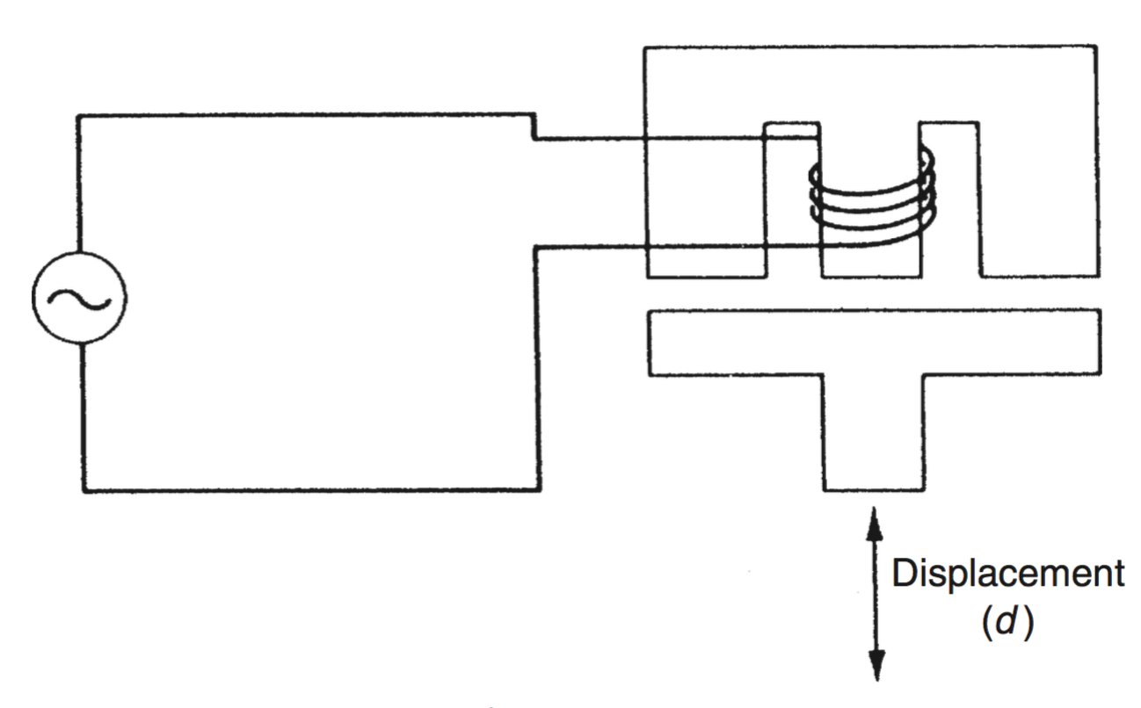
Sensors
[Magnetic Sensors]
The inductive displacement transducer:
The single winding on the central limb of an “E”-shaped ferromagnetic body is excited with an alternating voltage.
The displacement to be measured is applied to a ferromagnetic plate in close proximity to the “E” piece.
Movements of the plate alter the flux paths and hence cause a change in the current flowing in the winding.
By Ohm’s law, the current flowing in the winding is given by

Slide 9
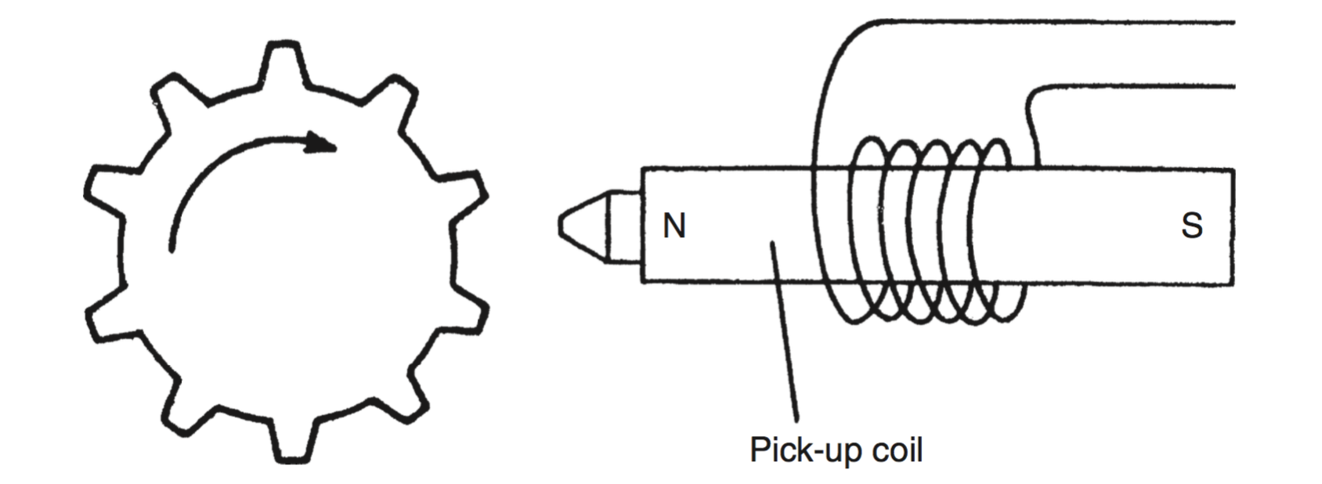
Sensors
[Magnetic Sensors]
The variable reluctance sensors: a coil is wound on a permanent magnet rather than on an iron core
Commonly to measure rotational velocities.
A typical instrument in which a ferromagnetic gearwheel is placed next to the sensor.
The tip of each tooth on the gearwheel moves toward and away from the pick-up unit,
The changing magnetic flux in the pickup coil causes a voltage to be induced in the coil whose magnitude is proportional to the rate of change of flux.
Resulting in a sequence of positive and negative pulses whose frequency is proportional to the rotational velocity of the gearwheel

Slide 10
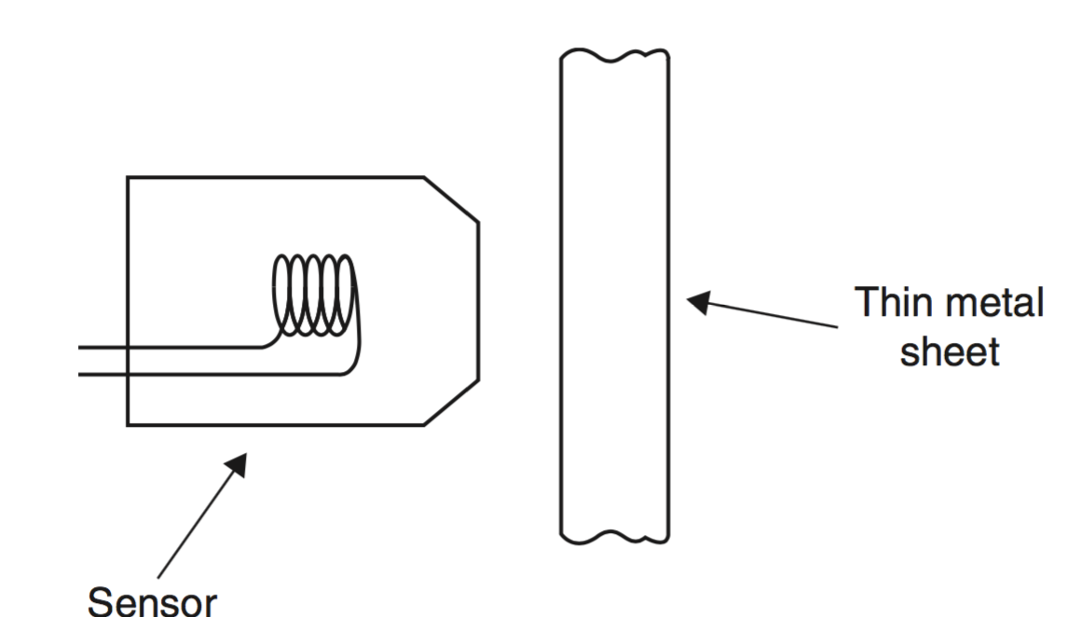
Sensors
[Magnetic Sensors]
Eddy current sensors: consist of a probe containing a coil that is excited at a high frequency typically 1 MHz
Used to measure the displacement of the probe relative to a moving metal target.
Because of the high frequency of excitation, eddy currents are induced only in the surface of the target, and the current magnitude reduces to almost zero a short distance inside the target.
This allows the sensor to work with very thin targets, such as the steel diaphragm of a pressure sensor.
The eddy currents alter the inductance of the probe coil, and this change can be translated into a d.c. voltage output that is proportional to the distance between the probe and the target.
Measurement resolution as high as 0.1 micrometer can be achieved. The sensor can also work with a nonconductive target if a piece of aluminum tape is fastened to it.

Slide 11
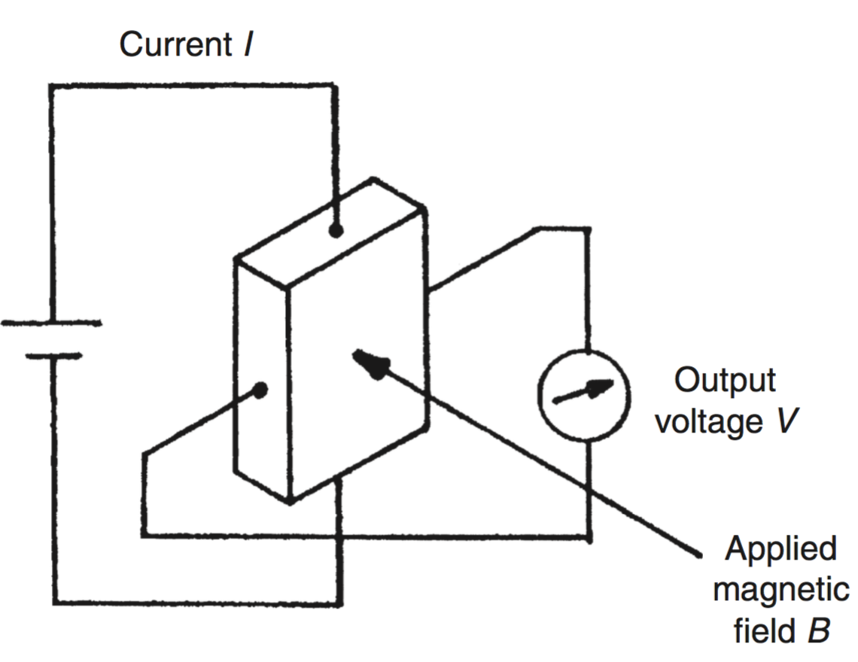

Sensors
[Hall-Effect Sensors]
Hall-effect sensor is a device used to measure the magnitude of a magnetic field.
It consists of a conductor carrying a current that is aligned orthogonally with the magnetic field.
This produces a transverse voltage difference across the device that is directly proportional to the magnetic field strength.
Conductor usually made from a Semiconductor materials for larger voltage production.
Commonly used as proximity sensors, computer keyboard pushbuttons,
Notes:
Computer starts from here

Slide 12
Sensors
[Piezoelectric Transducers/Sensors]
Piezoelectric transducers are made from piezoelectric materials
Have an asymmetrical lattice of molecules that distorts when a mechanical force is applied to it. Distortion causes a reorientation of electric charges within the material
Resulting in a relative displacement of positive and negative charges.
Induces surface charges on the material of opposite polarity between the two sides
Surface charges can be measured as an output voltage

Slide 13

Sensors
[Piezoelectric Transducers/Sensors]
For a rectangular block of material, the induced voltage is given by
The Polarity of the induced voltage depends whether the device is compressed or stretched.
The input impedance of the instrument must be very high, particularly where static or slowly varying displacements are being measured
Materials exhibiting piezoelectric behavior include natural ones such as quartz, synthetic ones such as lithium sulphate, and ferroelectric ceramics such as barium titanate.

Slide 14
Sensors
[Piezoelectric Transducers/Sensors]
The piezoelectric constant varies widely between different materials. Typical values of k are 2.3 for quartz and 140 for barium titanate.
Applying a force of 1 g applied to a crystal of area 100 mm² and a thickness of 1 mm gives an output of 23 mV for quartz and 1.4 mV for barium titanate.

Slide 15
Sensors
[Piezoelectric Transducers/Sensors]
Piezoelectric transducers produce an output voltage when a force is applied to them.
In Reverse Mode: A voltage applied to them produces an output force.
They are used frequently as ultrasonic transmitters and receivers: sinusoidal amplitude variations in the ultrasound wave received are translated into sinusoidal changes in the amplitude of the force applied to the piezoelectric transducer.
They are also used as displacement transducers, particularly as part of devices measuring acceleration, force, and pressure: translational movement in a displacement transducer is caused by mechanical means to apply a force to the piezoelectric transducer

Slide 16
Sensors
[Piezoelectric Transducers/Sensors]
Certain polymeric films such as polyvinylidine also exhibit piezoelectric properties.
higher voltage output than most crystals
Useful in many applications where displacement needs to be translated into voltage.
They have very limited mechanical strength and are unsuitable for applications where resonance might be generated in the material.
Piezoelectric principle is invertible, and therefore distortion in a piezoelectric material can be caused by applying a voltage to it.
Commonly in ultrasonic transmitters,
Application of a sinusoidal voltage at a frequency in the ultrasound range
Causes sinusoidal variations in the thickness of the material and results in a sound wave being emitted at the chosen frequency.

Slide 17
Sensors
[Strain Gauges/Sensors]
Strain gauges: Devices that experience a change in resistance when they are stretched or strained.
Able to detect very small displacements, usually in the range of 0-50 mm,
Typically used as part of other transducers,
E.g diaphragm pressure sensors that convert pressure changes into small displacements of the diaphragm.

Slide 18
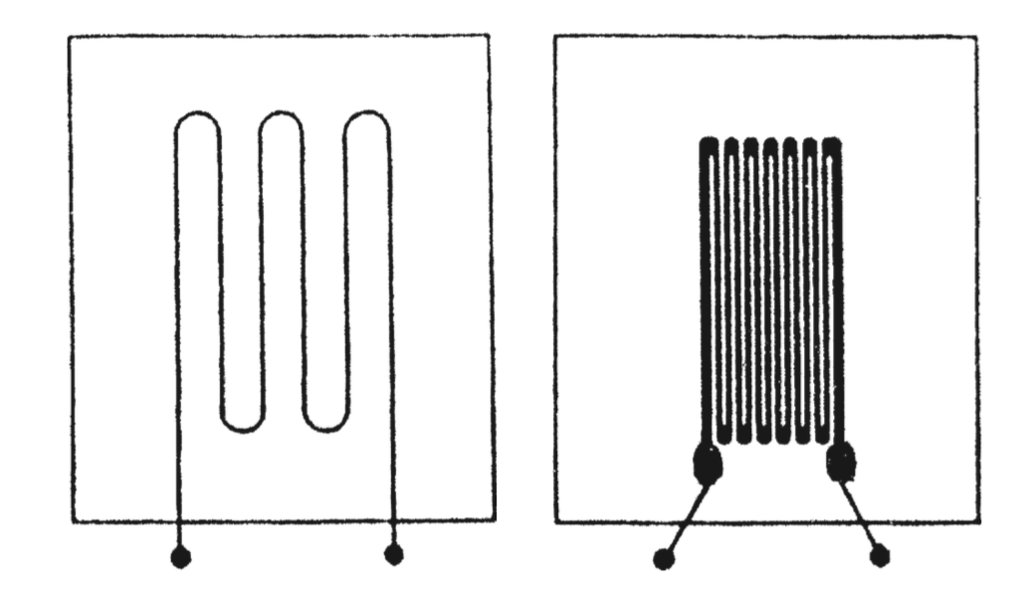
Sensors
[Strain Gauges/Sensors]
The traditional type of strain gauge consists of a length of metal resistance wire formed into a zigzag pattern and mounted onto a flexible backing sheet
The wire is nominally of circular cross section.
Strain distorts the shape of the cross section (Area) of the resistance wire.
Hence Consequential change in resistance.
The input–output relationship expressed by the gauge factor: change in resistance (R) per a given value of strain (S), that is, gauge factor = dR/dS.

Slide 19
Sensors
[Strain Gauges/Sensors]
In recent years: metal-foil types and semiconductor types are common.
Metal-foil types are very similar to metal- wire types except that the active element consists of a piece of metal foil cut into a zigzag pattern.
Cutting a foil into the required shape is much easier than forming a piece of resistance wire into the required shape
Which reduces manufacturing cost
Material in metal strain gauge manufacture is a copper–nickel–manganese alloy
Trade name is “Advance.”

Slide 20
Sensors
[Strain Gauges/Sensors]
Semiconductor types have piezoresistive elements
Have superior gauge factor (up to 100 times better) than Metal but are more expensive.
ave a relatively high temperature coefficient.
Strain gauges are bonded to the object whose displacement is to be measured.
Bonding presents difficulty, particularly for semiconductor types.
Resistance of the gauge is usually measured by a d.c. bridge circuit, and the displacement is inferred from the bridge output measured.
Maximum current in the region of 5 to 50 mA depending on the type.
Thus, maximum required voltage limited ,thus resistance change in a strain gauge is typically small,
The bridge output voltage is also small and amplification has to be carried out.
This adds to the cost of using strain gauges.

Slide 21
Sensors
[Piezoresistive Sensors]
Piezoresistive materials: Resistance varies greatly when the sensor is compressed or stretched.
A piezoresistive sensor is made from semiconductor material in which a p-type region has been diffused into an n-type base.
Used as strain gauge, where it produces a significantly higher gauge factor than that given by metal wire or foil gauges.
Also, measurement uncertainty can be reduced.
It is also used in semiconductor-diaphragm pressure sensors and in semiconductor accelerometers.

Slide 22
Sensors
[Piezoresistive Sensors]
Piezoresistive sensor is sometimes used to describe all types of strain gauges.
Incorrect as only about 10% of the output from a metal strain gauge is generated by piezoresistive effects, with the remainder arising out of the dimensional cross-sectional change in the wire or foil.
Proper piezoelectric strain gauges (a.k.a semiconductor strain gauges), produce most (about 90%) of their output through piezoresistive effects,
Only a small proportion of the output is due to dimensional changes in the sensor.

Slide 23
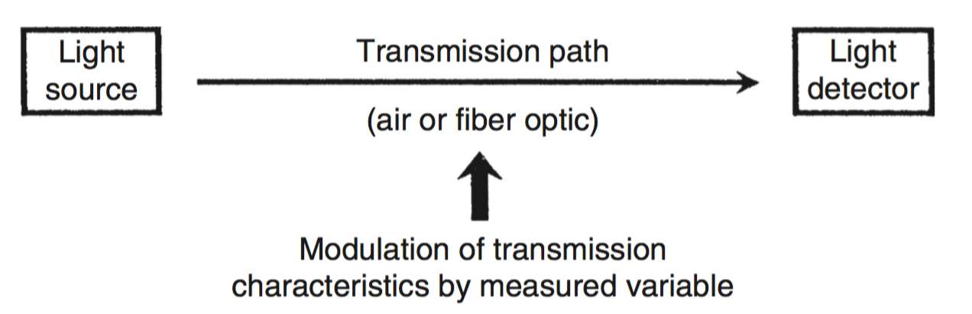
Sensors
[Optical Sensors]
Optical sensors are based on the transmission of light between a light source and a light detector.
The transmitted light can travel along either an air path or a fiber-optic cable.
Immunity to electromagnetically induced noise and
Greater safety than electrical sensors when used in hazardous environments.

Slide 24
Sensors
[Optical Sensors: Air Path]
Air path optical sensors are commonly to measure:
proximity, translational motion, rotational motion, and gas concentration.
Different Types exist
Light sources: tungsten-filament lamps, laser diodes, and light-emitting diodes (LEDs).
Light from tungsten lamps (usually visible light), thus prone to interference from the sun and other sources.
Hence, infrared LEDs or infrared laser diodes are usually preferred.
These emit light in a narrow frequency band in the infrared region and are not affected by sunlight.

Slide 25
Sensors
[Optical Sensors: Air Path]
Air path optical sensors are commonly to measure:
proximity, translational motion, rotational motion, and gas concentration.
Different Types exist
Light sources: tungsten-filament lamps, laser diodes, and light-emitting diodes (LEDs).
Light from tungsten lamps (usually visible light), thus prone to interference from the sun and other sources.
Hence, infrared LEDs or infrared laser diodes are usually preferred.
These emit light in a narrow frequency band in the infrared region and are not affected by sunlight.
Light Detectors: photoconductors (photoresistors), photovoltaic devices (photocells), phototransistors, and photodiodes.

Slide 26
Sensors
[Optical Sensors: Air Path]
Air path optical sensors are commonly to measure:
proximity, translational motion, rotational motion, and gas concentration.
Different Types exist
Light sources: tungsten-filament lamps, laser diodes, and light-emitting diodes (LEDs).
Light from tungsten lamps (usually visible light), thus prone to interference from the sun and other sources.
Hence, infrared LEDs or infrared laser diodes are usually preferred.
These emit light in a narrow frequency band in the infrared region and are not affected by sunlight.
Light Detectors: photoconductors (photoresistors), photovoltaic devices (photocells), phototransistors, and photodiodes.

Slide 27
Sensors
[Optical Sensors: Air Path]
Photoconductive devices (a.k.a. photoresistors): Convert changes in incident light into changes in resistance.
Resistance reducing according to the intensity of light.
Made from materials such as cadmium sulfide, lead sulfide, and indium antimonide.
Photovoltaic devices(often called photocells or solar cells when in array): Generate an output voltage whose magnitude is a function of the magnitude of the incident light
Made from various types of semiconductor material.
Photodiodes are devices where the output current is a function of the amount of incident light.
Made from various types of semiconductor material.

Slide 28
Sensors
[Optical Sensors: Air Path]
A phototransistor is effectively a standard bipolar transistor with a transparent case that allows light to reach its base-collector junction.
Output in the form of an electrical current and could be regarded as a photodiode with an internal gain.
More sensitive to light than a photodiode, particularly in the infrared region,
Has a slower response time.
Ideal partner for infrared LED and laser diode light sources.

Slide 29
Sensors
[Optical Sensors: Fiber Optic]
Transmission medium between a source and a detector fiber-optic cable.
Fiber-optic cables made from plastic fibers, glass fibers, or both
Only glass fibers cables not common as these are very fragile.
Plastic fibers cables advantageous for sensor applications
Are Inexpensive
Relatively large diameter of 0.5 1.0 mm makes connection to the transmitter and receiver easy.
Cannot be used in hostile environments.
The cost of fiber-optic cable itself is insignificant for sensing applications, as the Total cost of the sensor is dominated by the cost of the transmitter and receiver.
Characteristically have long life, good accuracy, their simplicity, low cost, small size, high reliability, and capability of working in many kinds of hostile environments.
Design difficulty is maximizing the proportion of light entering the cable.
Two major classes : intrinsic (fiber-optic cable itself is sensor) and extrinsic (fiber optic cable only transmits).

Slide 30
Sensors
[Optical Sensors: Fiber Optic]
In intrinsic sensors: the physical quantity being measured causes some measurable change in the characteristics of the light transmitted by the cable.
The modulated light parameters include: intensity, phase, polarization, wavelength, transit time.
Extrinsic sensors: To transmit modulated light from a conventional sensor such as a resistance thermometer.
Have ability to reach places that are otherwise inaccessible. E.g. inside of a jet engines of aircraft, internal temperature of electrical transformers.

Slide 31
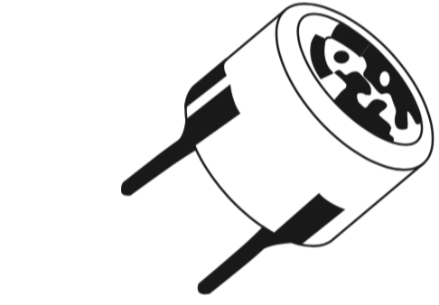
Sensors
[Ultrasonic Transducers/Sensors]
Ultrasound is a band of frequencies in the range above 20 kHz, that is, above the sonic range that humans can usually hear.
Used for measuring fluid flow rates, liquid levels, and translational displacements.
Consists of one device that transmits an ultrasound wave and another device that receives the wave.
Change variables include: time-of-flight, phase, frequency.
Common example is a piezoelectric crystal contained in a casing.
Can operate interchangeably as either a transmitter or a receiver.
Operating frequencies that vary between 20 kHz and 15 MHz
NB: There are also capacitive ultrasonic Sensors with frequency range of about 30 kHz and 3 MHz

Slide 32
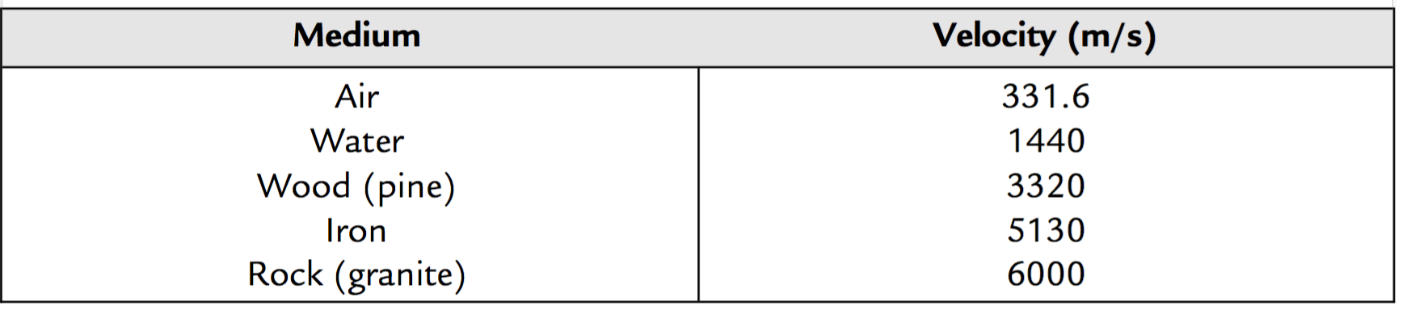
Sensors
[Ultrasonic Transducers/Sensors]
Transmission Speed: Varies according to the Medium of transmission.
Through air, the speed of ultrasound is affected by environmental factors such as temperature, humidity, and air turbulence.
Temperature: Has the largest effect. V= 331:6 þ 0:6T m/s. T is the temperature in deg C. Thus, a change of 20 degC from 0 to 20 C, the velocity changes from 331.6 to 343.6 m/s.
Humidity changes have a much smaller effect on speed.
Changes in air pressure itself have a negligible effect on the velocity of ultrasound.
Air turbulence normally has no effect. However, if turbulence involves currents of air at different temperatures, then random changes in ultrasound velocity occur.

Slide 33
Sensors
[Ultrasonic Transducers/Sensors]
Transmission Speed: Varies according to the Medium of transmission.
Through air, the speed of ultrasound is affected by environmental factors such as temperature, humidity, and air turbulence.
Temperature: Has the largest effect. V= 331:6 þ 0:6T m/s. T is the temperature in deg C. Thus, a change of 20 degC from 0 to 20 C, the velocity changes from 331.6 to 343.6 m/s.
Humidity changes have a much smaller effect on speed.
Changes in air pressure itself have a negligible effect on the velocity of ultrasound.
Air turbulence normally has no effect. However, if turbulence involves currents of air at different temperatures, then random changes in ultrasound velocity occur.

Slide 34
Sensors
[Ultrasonic Transducers/Sensors]

